Slide 1







DBMS
Lab-4

Slide 2
Things we will complete today
Query on single relation (continue) MySQL Comparison Operators

Slide 3
MySQL Comparison Operators

Slide 4
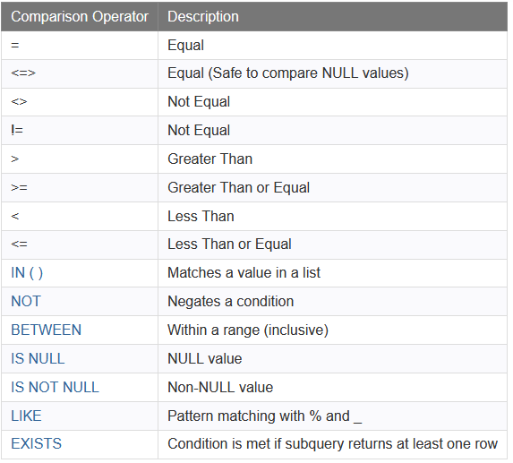
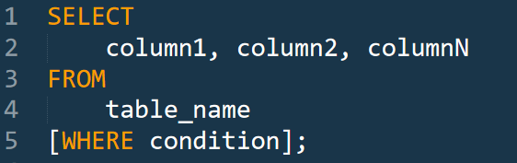
Comparison Operations
Comparison operators are used in the WHERE clause to determine which records to select.

Slide 5
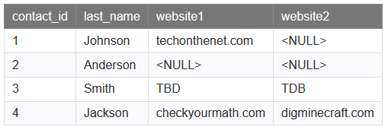
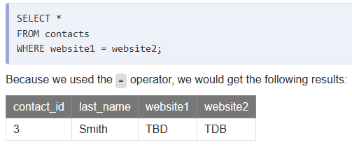
The = operator
Example:

Slide 6
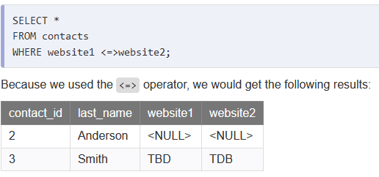
The <=> operator
Example:

Slide 7


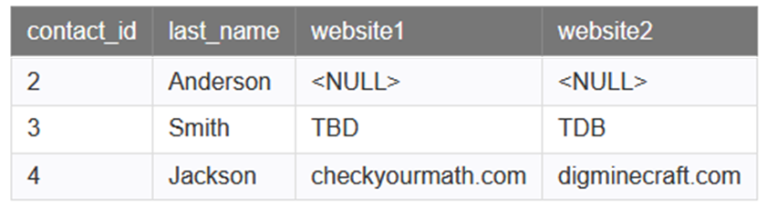
The Inequality Operator <> and !=
Example:

Slide 8
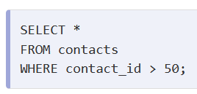
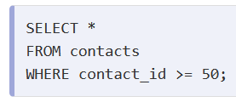
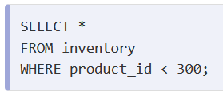
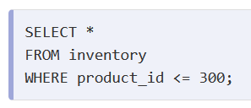
The >, >=, < and <=
Example:

Slide 9
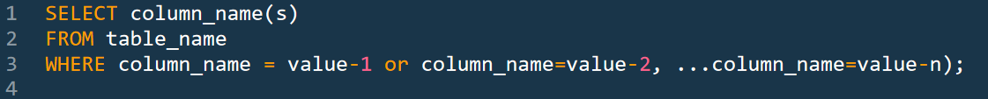

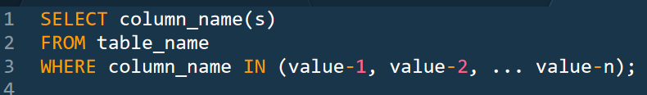
The in(…) operator
The IN operator allows you to specify multiple values in a WHERE clause.
The IN operator is a shorthand for multiple OR conditions.

Slide 10
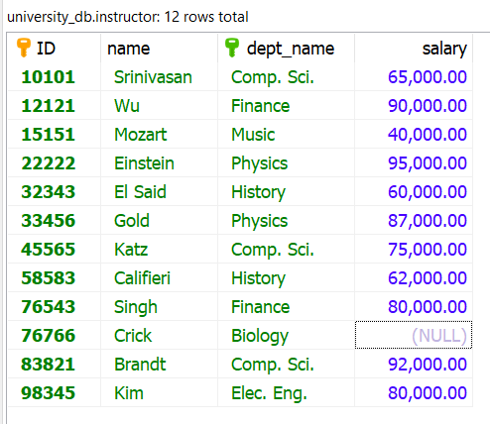
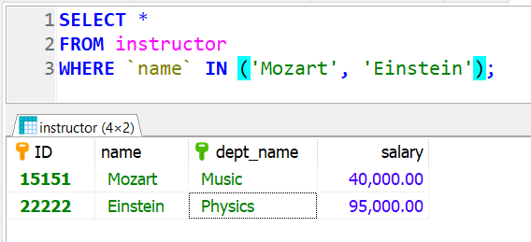
The in(…) operator
selects the names of instructors whose names are either “Mozart” or “Einstein”

Slide 11
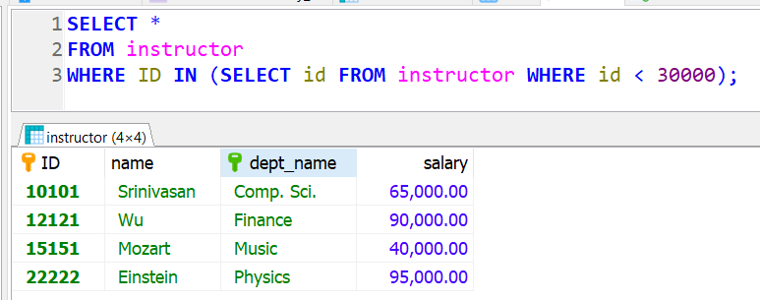
The in(…) operator
Using ‘in’ selects the names of instructors whose ids are less than 30000

Slide 12
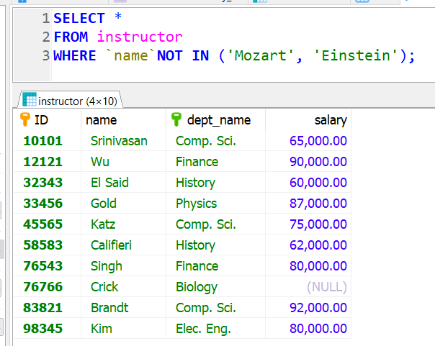
The not in(…) operator
selects the names of instructors whose names are neither “Mozart” nor “Einstein”

Slide 13
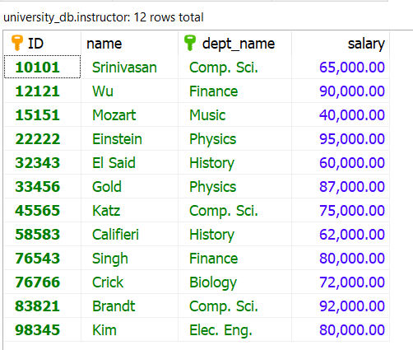
The between operator
between comparison operator is used to simplify where clauses that specify that a value be less than or equal to some value and greater than or equal to some other value

Slide 14
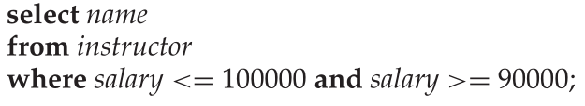
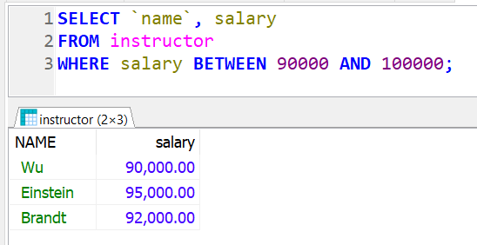
The between operator
find the names of instructors with salary amounts between $90,000 and $100,000

Slide 15
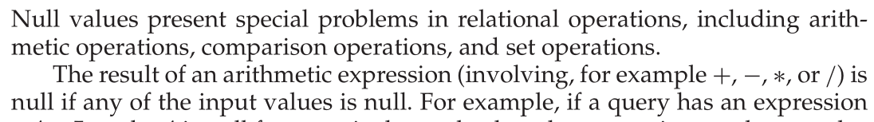
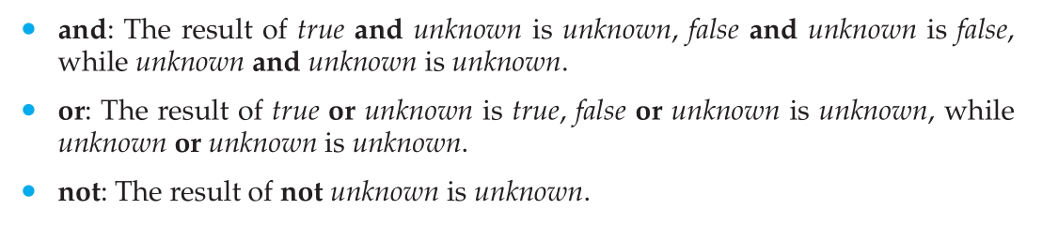
The is null operator

Slide 16
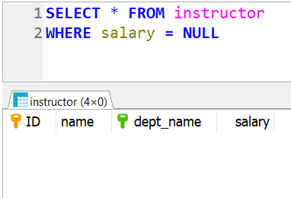
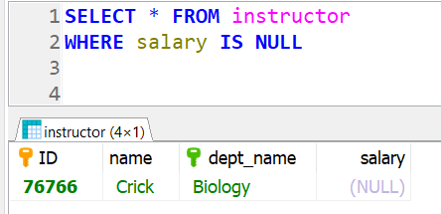
The is null operator
SQL uses the special keyword null in a predicate to test for a null value
Find the names of instructors whose salary is unknown.

Slide 17
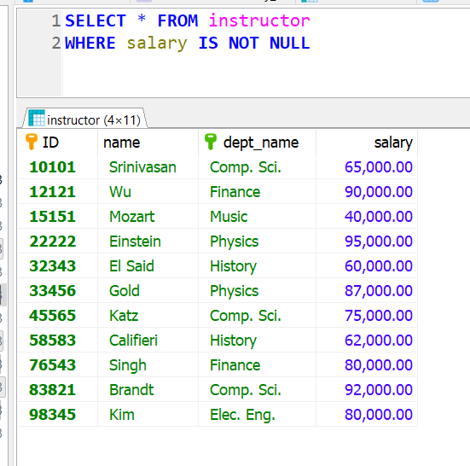
The is not null operator
The opposite of is null
Find the names of instructors whose salary we know.

Slide 18
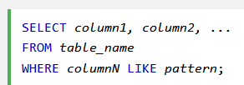
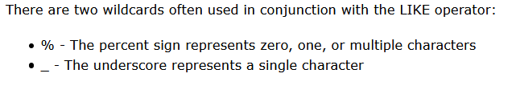
The like operator
The LIKE operator is used in a WHERE clause to search for a specified pattern in a column

Slide 19
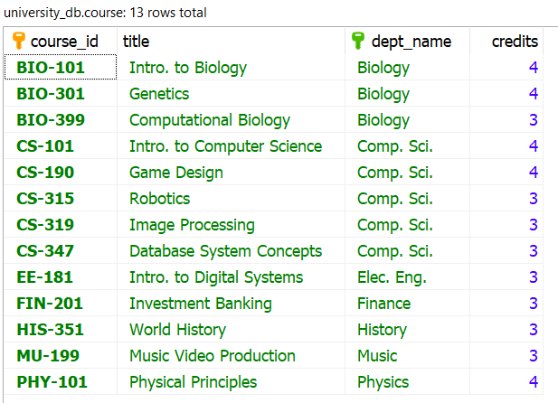
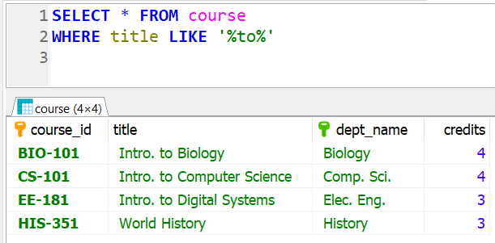
The like operator
Find the names of all courses whose title includes the substring ‘to’.

Slide 20
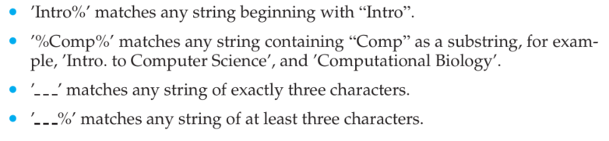
The like operator

Slide 21
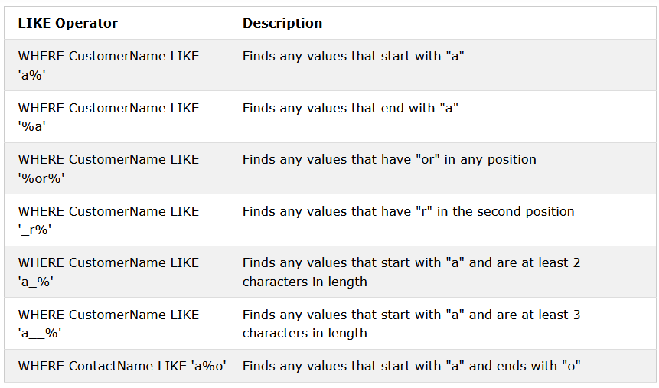
The like operator

Slide 22
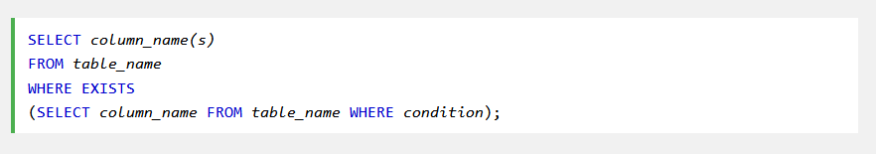
The exists operator
The EXISTS operator is used to test for the existence of any record in a subquery.
The EXISTS operator returns true if the subquery returns one or more records

Slide 23
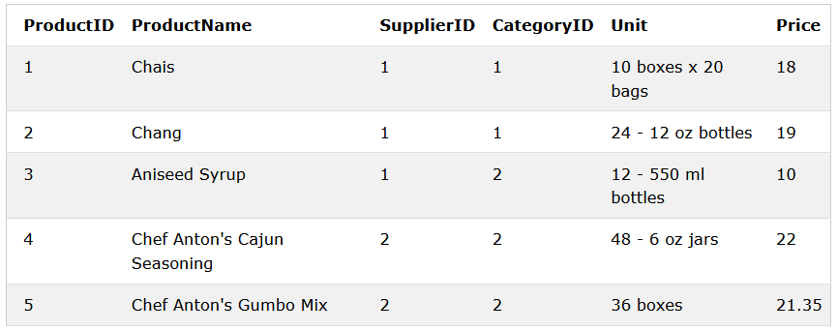
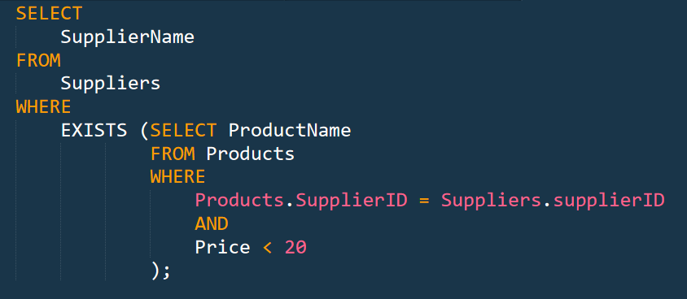
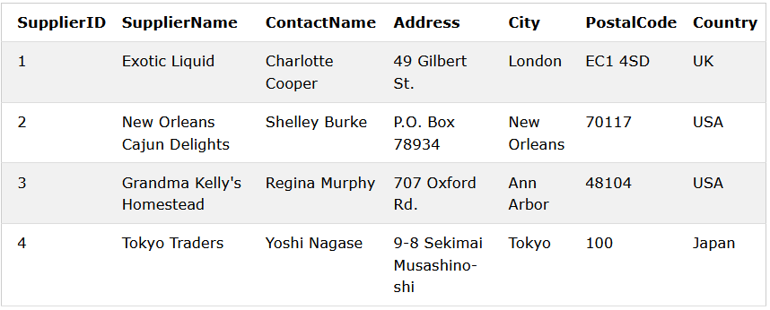
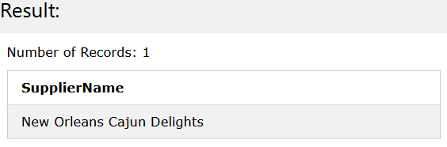
The exists operator
The following SQL statement returns TRUE and lists the suppliers with a product price less than 20

Slide 25
Demo.

Slide 26
End.

